Slide 1


Slide 2

CHAPTER
IV

Slide 3
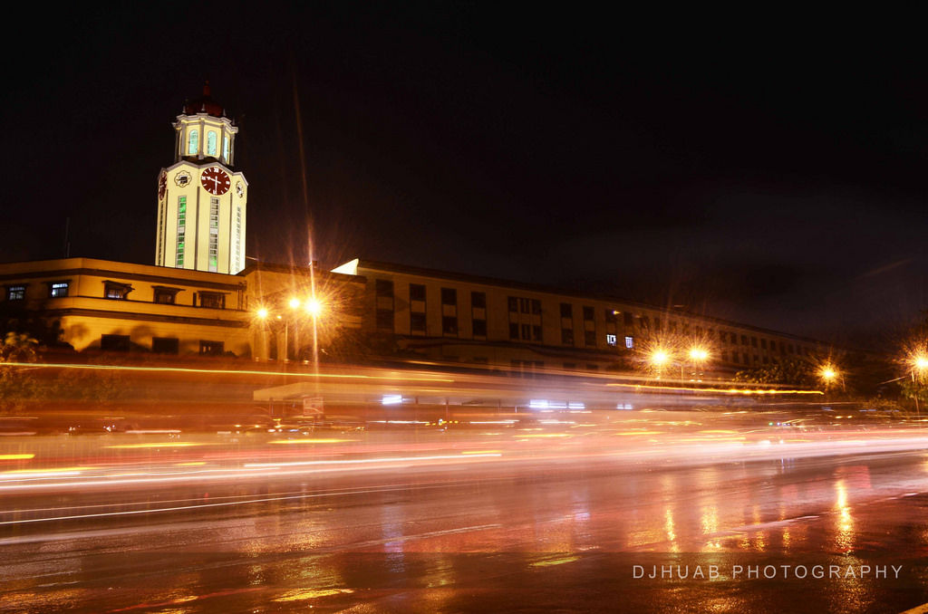
TAXATION
LOCAL
CHAPTER IV

Slide 4
A LOCAL TAX IS TAX ASSESSED AND LEVIED BY A LOCAL AUTHORITY SUCH AS A STATE, COUNTY OR MUNICIPALITY. A LOCAL TAX IS USUALLY COLLECTED IN THE FORM OF PROPERTY TAXES, AND IS USED TO FUND A WIDE RANGE OF CIVIC SERVICES FROM GARBAGE COLLECTION TO SEWER MAINTENANCE. THE AMOUNT OF LOCAL TAXES MAY VARY WIDELY FROM ONE JURISDICTION TO THE NEXT.
LOCAL
TAXATION

Slide 5
LOCAL
TAXATION
LOCAL TAX IS ALSO REFERRED TO AS MUNICIPAL TAX.

Slide 6
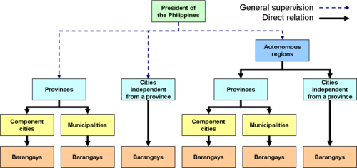
Source: https://upload.wikimedia.org/wikipedia/commons/thumb/a/af/Philippine_local_government.png/500px-Philippine_local_government.png

Slide 7




LOCAL GOVERNMENT UNIT
-PROVINCES AND INDEPENDENT CITIES
- COMPONENT CITIES AND MUNICIPALITIES
- BARANGGAYS

Slide 8
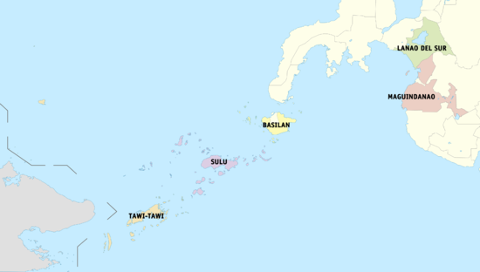
LOCAL GOVERNMENT UNIT
- AUTONOMOUS

Slide 9

Is the executive department responsible for promoting peace and order, ensuring public safety, and strengthening the capability of local government units to effectively deliver basic services to the citizenry.

Slide 10
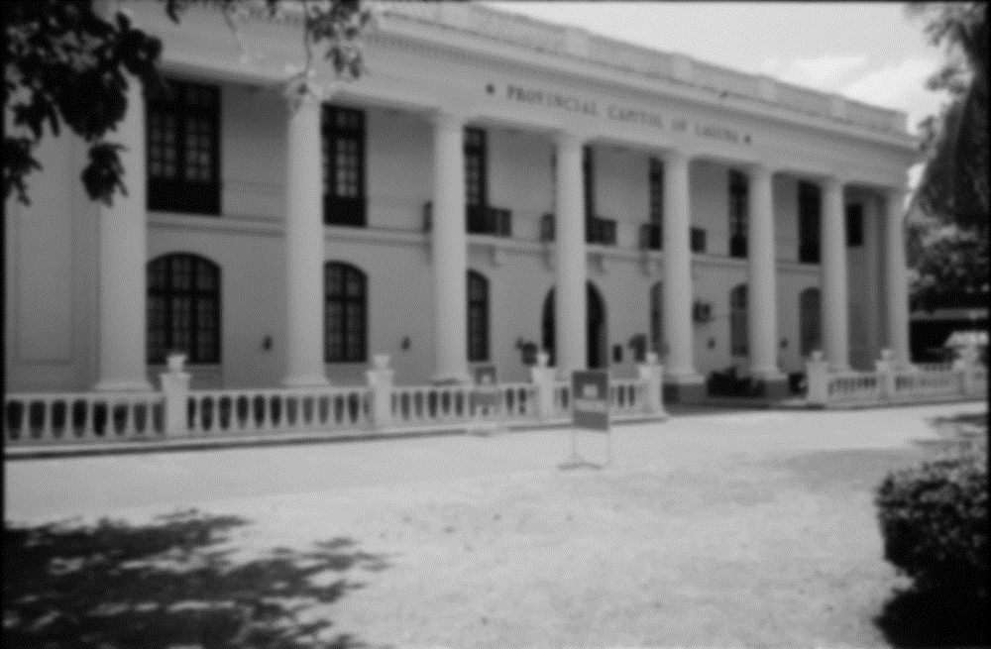

It’s a form of public administration which in, a majority of context exist as lower tier of administration within a given state
LOCAL GOVERNMENT

Slide 11


Slide 12
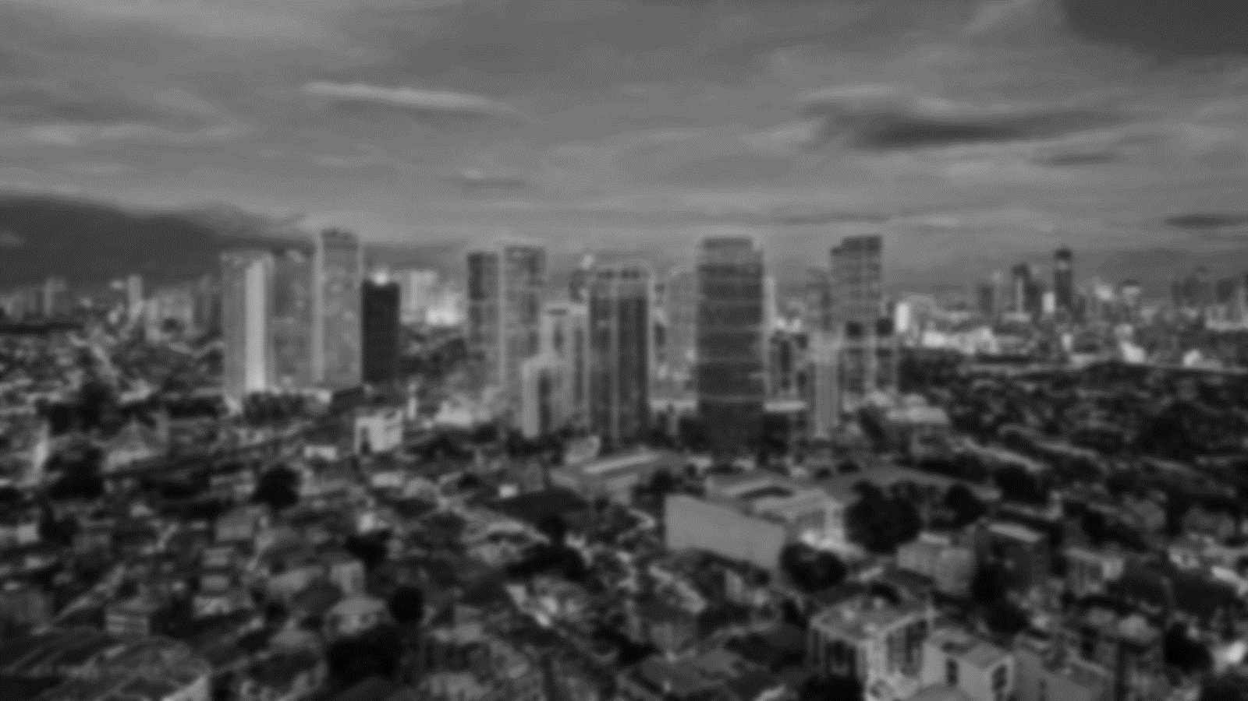
The power granted to a governmental body to levy and collect taxes. It is used as a means of accomplishing Congress’s delegated powers.
TAXING POWER

Slide 13

TAX COLLECTION

Slide 14


Slide 15
Failure to pay taxes, penalties or interest when due or assessed, or to comply with the tax laws may result in the following actions
TAX COLLECTION

Slide 16
-Liens may be placed upon your real estate, personal property…
-Distraint may be issued and the seized property sold with the proceeds applied to the balance owed.
TAX COLLECTION

Slide 17

TAX PERIOD AND MANNER OF PAYMENT

Slide 18
TAX PERIOD AND MANNER OF PAYMENT
A “tax year” is an annual accounting period for keeping records and reporting income and expenses. An annual accounting period does not include a short tax year. The tax years you can use are: Calendar year - 12 consecutive months beginning January 1 and ending December 31.

Slide 19
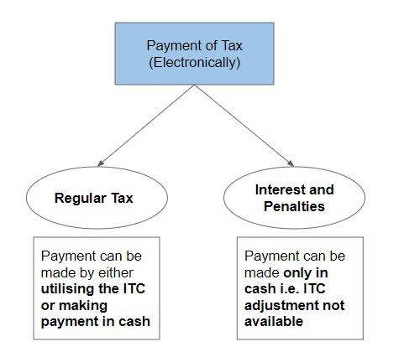
TAX PERIOD AND MANNER OF PAYMENT

Slide 20
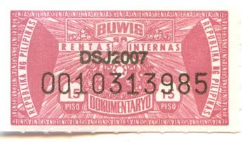
TAX PERIOD AND MANNER OF PAYMENT
DOCUMENTARY STAMP IN THE PHILIPPINES

Slide 21

ACCRUAL OF TAX

Slide 22
Accrual of tax refers to a taxes assessed against the company that had not yet been paid, whether the taxes are on the company’s earned revenue or on the value of the property of any company owns.
ACCRUAL OF TAX

Slide 23
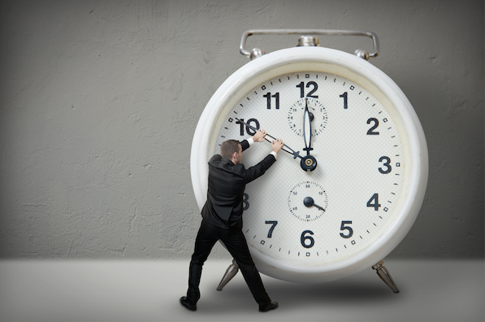
TIME OF PAYMENT
Time of payment of claims provision. A provision that requires claims be paid immediately, or within a stated number of days.

Slide 24
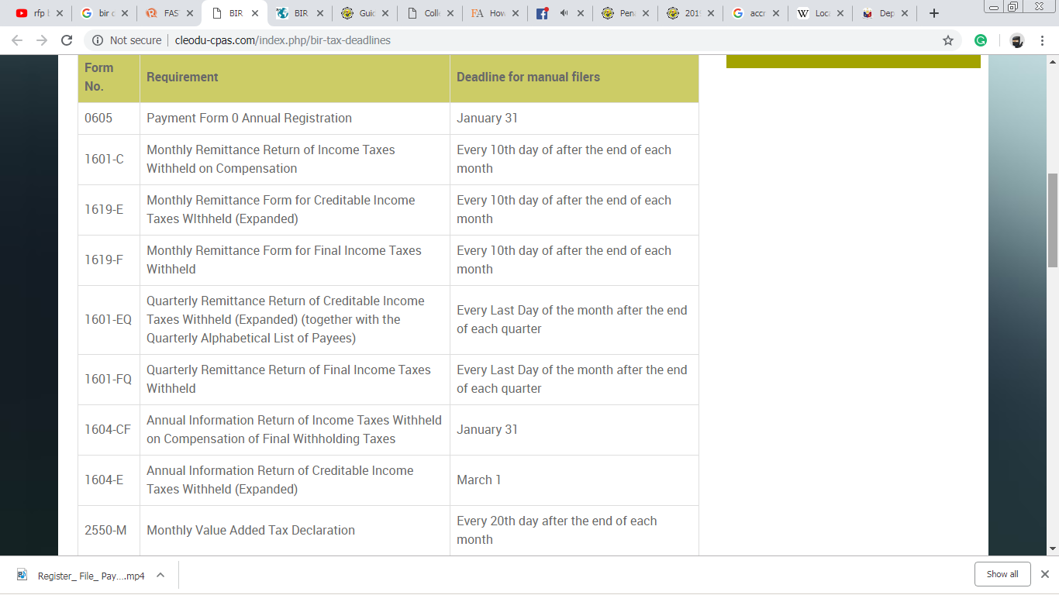
TIME OF PAYMENT

Slide 25
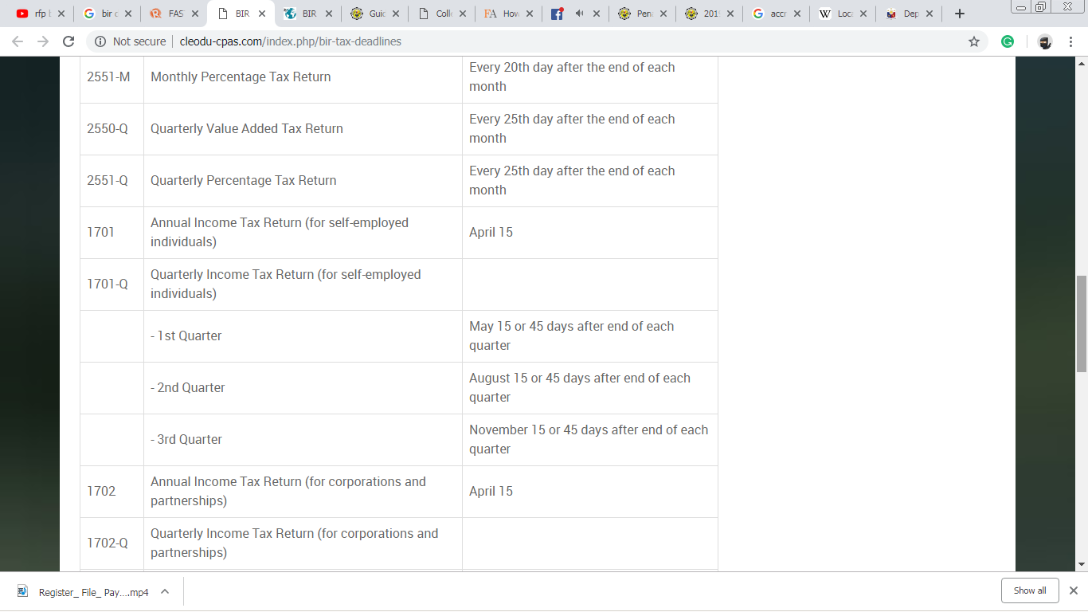
TIME OF PAYMENT

Slide 26
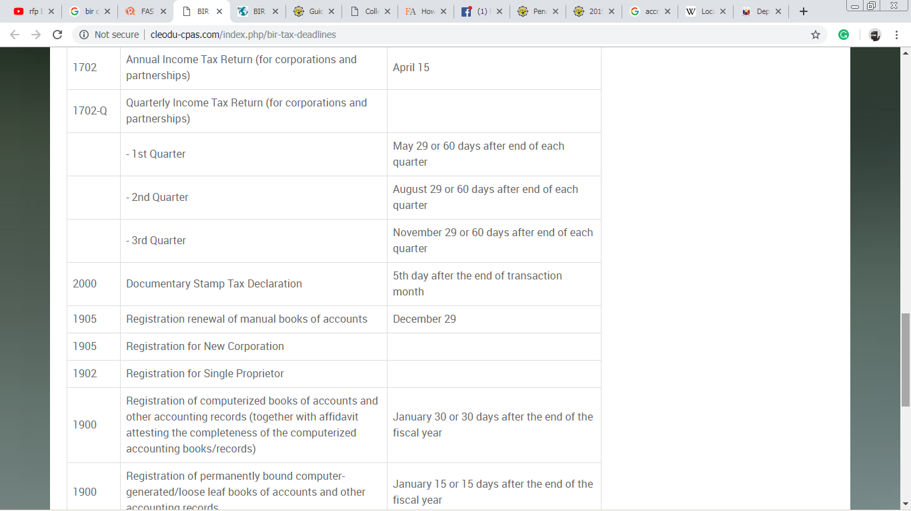
TIME OF PAYMENT

Slide 27
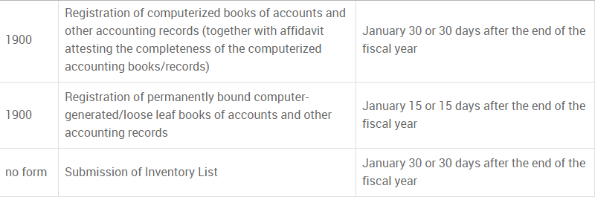
TIME OF PAYMENT

Slide 28
TIME OF PAYMENT

Slide 29


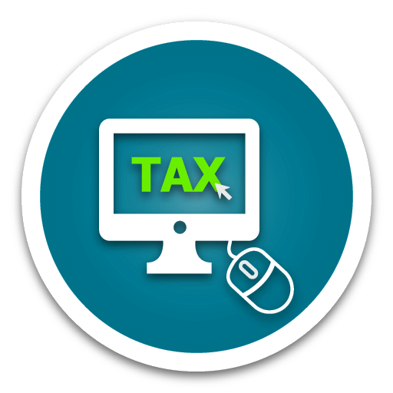
SURCHARGES AND PENALTIES ON UNPAID TAXES, FEES OR CHARGES

Slide 30
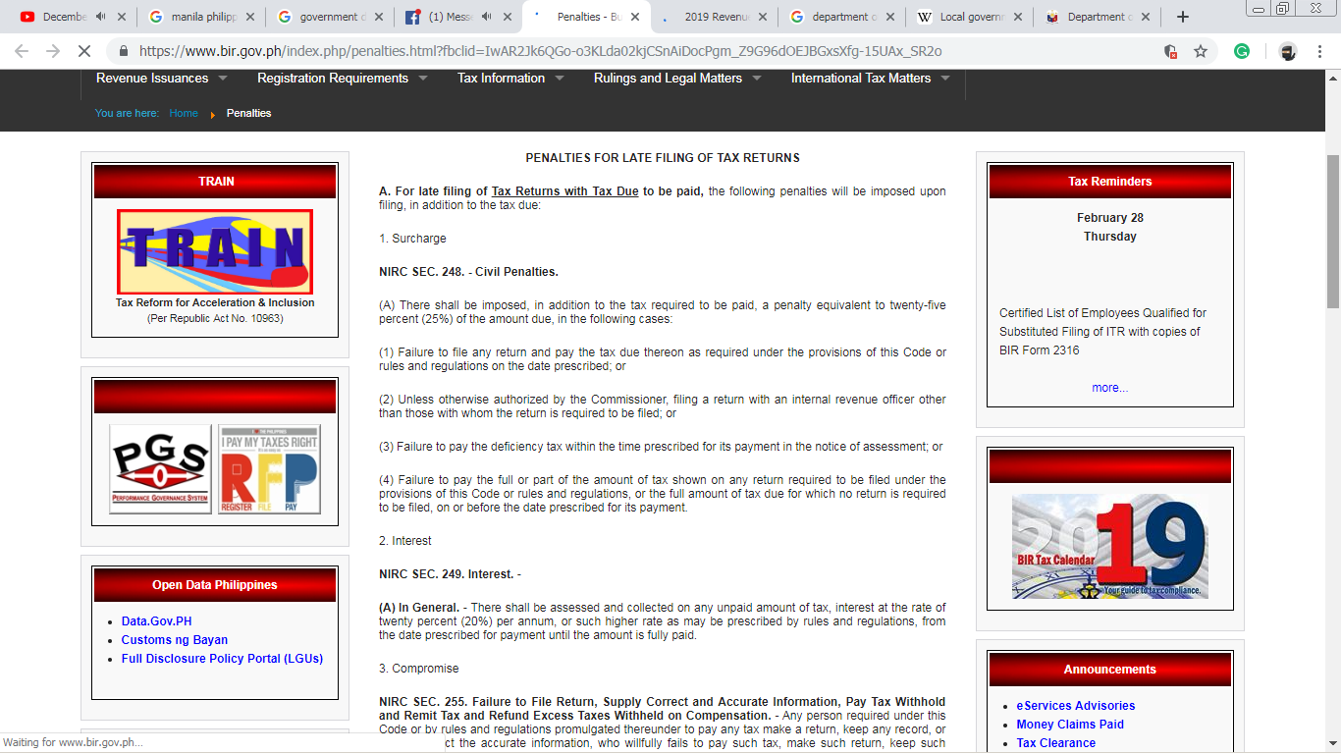
SURCHARGES AND PENALTIES ON UNPAID TAXES, FEES OR CHARGES

Slide 31
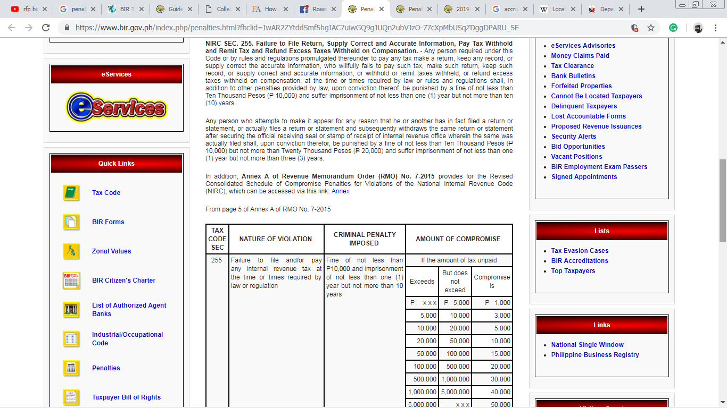
SURCHARGES AND PENALTIES ON UNPAID TAXES, FEES OR CHARGES

Slide 32
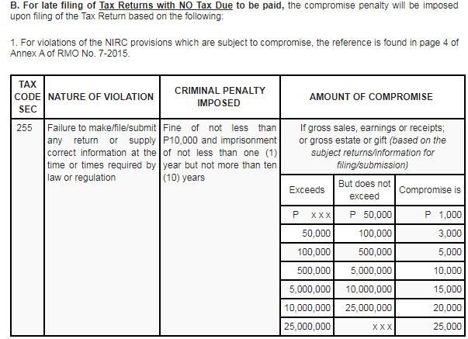
SURCHARGES AND PENALTIES ON UNPAID TAXES, FEES OR CHARGES

Slide 33
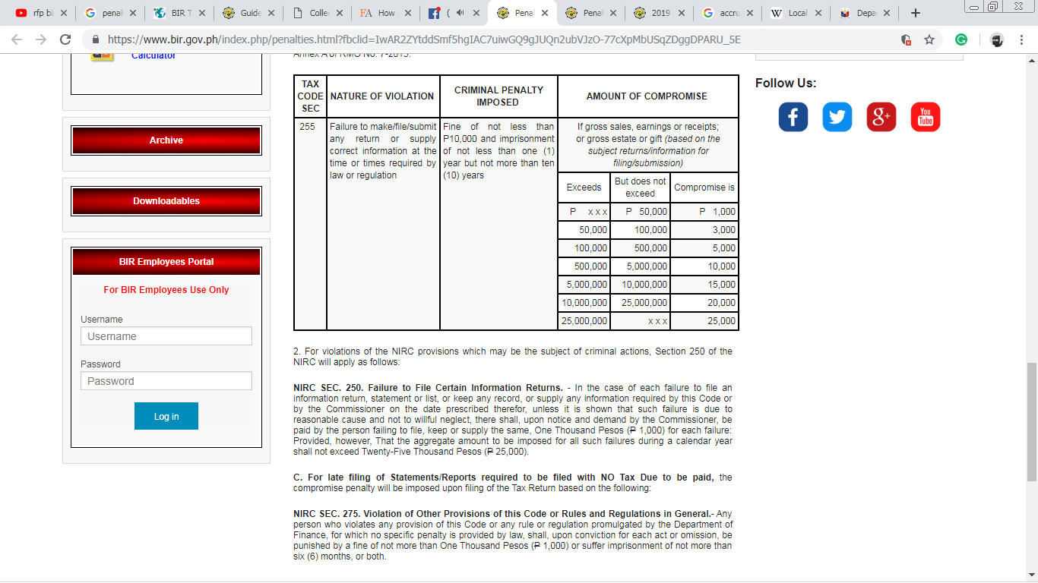
SURCHARGES AND PENALTIES ON UNPAID TAXES, FEES OR CHARGES

Slide 34

INTEREST ON OTHER PAID REVENUES

Slide 35
BIR clarifies imposition of 12% interest on unpaid taxes (Revenue Regulations No. 21-2018, September 14, 2018)
INTEREST ON OTHER PAID REVENUES

Slide 36
Pursuant to the TRAIN law, the interest on deficiency and delinquency taxes shall be double the effective legal interest. In RR 21-2018, the BIR clarifies the following:
INTEREST ON OTHER PAID REVENUES

Slide 37
The deficiency interest shall be 12% per year which is double the 6% legal interest on loans pursuant to BSP Memorandum No. 799, s. 2013. The deficiency interest shall be imposed from the date prescribed for payment until full payment or until issuance of notice and demand by the BIR, whichever comes first.
INTEREST ON OTHER PAID REVENUES

Slide 38

THANK YOU !

